Slide 1

Green Pace
Security Policy Presentation
Developer: Evann Hopkins

Slide 2

OVERVIEW: DEFENSE IN DEPTH
Our security policy standardizes protections across all layers of Green Pace’s systems. It was needed because as our team grows, inconsistent practices could leave gaps. Defense in depth means even if one layer fails, others still protect critical data. For example, firewalls guard the network, input validation secures the code, and encryption shields stored data.

Slide 3
THREATS MATRIX
Likely SQL Injection, Cross Site Scripting | Priority Broken Authentication, Data Leaks
Low priority Hardcoded Secrets, Outdated Libraries | Unlikely Physical Breaches, Insider Threats

Slide 4
10 PRINCIPLES
Validate All Input - Standard 1 (Prevent SQLi/XSS by sanitizing user data).
Enforce Strong Authentication - Standard 2 (Require MFA for all admin access).
Apply Least Privilege - Standard 3 (Limit user permissions to only what’s needed).
Secure Error Handling - Standard 4 (Never expose system details in errors).
Encrypt Sensitive Data - Standard 5 (Use AES-256 at rest, TLS in transit).
Log and Monitor Actions - Standard 6 (Track all access with timestamps/IPs).
Keep Dependencies Updated - Standard 7 (Patch libraries monthly).
Use Trusted Components - Standard 8 (Vet third-party code before integration).
Implement Session Timeouts - Standard 9 (Auto-logout after 15 minutes of inactivity).
Regularly Audit Code - Standard 10 (Annual penetration tests + SAST scans).

Slide 5
CODING STANDARDS
Input Validation (Standard 1); Priority: Critical; Why: Blocks SQLi/XSS attacks. All user input must be sanitized.
Authentication Enforcement (Standard 2); Priority: High; Why: MFA prevents 99% of credential stuffing attacks.
Least Privilege Access (Standard 3); Priority: High; Why: Limits damage from compromised accounts (e.g., admin vs. user roles).
Secure Error Handling (Standard 4); Priority: Medium; Why: Generic error messages avoid leaking system details.
Data Encryption (Standard 5); Priority: High; Why: AES-256/TLS protect data even if breached.
Activity Logging (Standard 6); Priority: Medium; Why: Essential for auditing and incident response.
Dependency Updates (Standard 7); Priority: Medium; Why: Unpatched libraries are top exploit targets.
Vetted Components (Standard 8); Priority: Low; Why: Reduces risks from third-party code.
Session Timeouts (Standard 9); Priority: Low; Why: Mitigates risks of unattended active sessions.
Code Audits (Standard 10); Priority: Medium; Why: Annual pentests catch hidden vulnerabilities.

Slide 6
ENCRYPTION POLICIES
In Flight: TLS 1.3 for all APIs/web traffic.
At Rest: AES 256 for databases/file storage.
In Use: Memory encryption for sensitive processing.

Slide 7
TRIPLE-A POLICIES
Authentication: Mandatory MFA for all admins.
Authorization: Role based access controls (RBAC).
Accounting: Log all actions; audit logs kept for 1 year.

Slide 8
UNIT TESTING
Test 1: Does input validation block SQL injection attempts? Test Case: Send payload ' OR 1=1-- to login form Expected Result: Rejected with "Invalid input" error Actual Result: PASS (attack blocked) Next Step: Expand to test XSS payloads like <script>alert(1)</script>
Test 2: Does authentication fail with invalid credentials? Test Case: Submit fake username/password (test:12345) Expected Result: Returns 401 Unauthorized Actual Result: PASS (access denied) Next Step: Add brute-force lockout test
Test 3: Can users access admin endpoints without privileges? Test Case: Regular user tries to GET /api/admin/users Expected Result: Returns 403 Forbidden Actual Result: FAIL (endpoint leaked data) → Bug found Fix Required: Add role-based middleware
Test 4: Are error messages exposing system details? Test Case: Trigger DB connection error Expected Result: Generic "Service unavailable" message Actual Result: PASS (no stack traces visible)

Slide 9
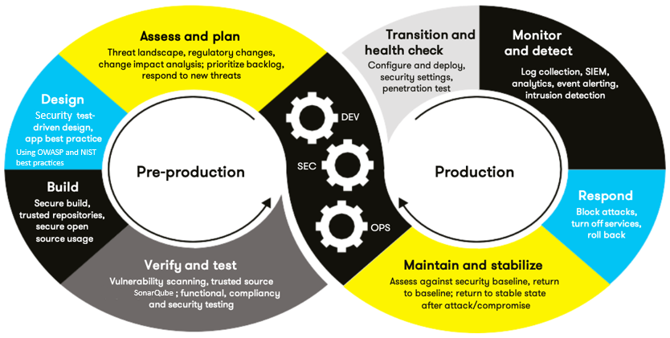
AUTOMATION SUMMARY

Slide 10
TOOLS
SonarQube: Static code analysis in CI pipeline.
OWASP ZAP: Dynamic scans during testing.
SIEM (Splunk): Real time intrusion detection.

Slide 11
RISKS AND BENEFITS
Act Now: Fewer breaches but slower releases.
Wait: Faster updates but higher breach risk.
Gaps: Third party libraries lack audits.

Slide 12
RECOMMENDATIONS
Adopt software bills of materials (SBOMs).
Require annual threat modeling workshops.

Slide 13
CONCLUSIONS
Future focus: Zero trust architecture, automated red teaming.

Slide 14
REFERENCES
IBCShow. (2018, June 21). What motivates hackers? https://www.youtube.com/watch?v=BoWouwPGtVY
McAfee. (2011, March 16). 7 types of hacker motivations. Archived at WebArchive. https://web.archive.org/web/20210413134404/https://www.mcafee.com/blogs/consumer/family-safety/7-types-of-hacker-motivations/

